Slide 1
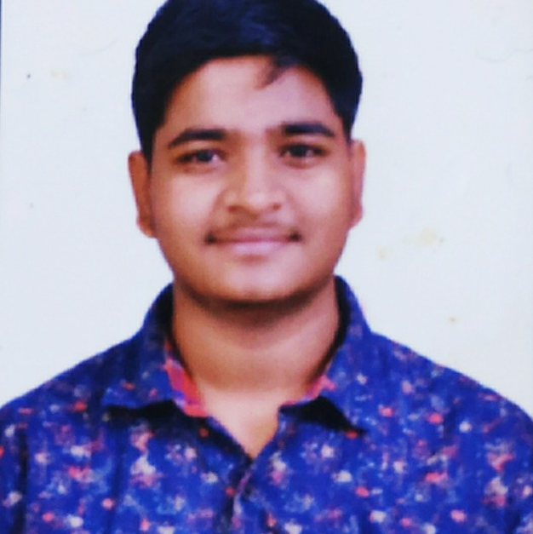


SALUNKE OMKAR ARJUN
Analyst/Software Engineer
Bachelor of Engineering
Mechanical Engineering :2018-2021
Skills
Core Java | Java Basics, OOPS, Collections, Arrays, Loops, Lambda Exp, Stream API Junit.
Spring core | IOC & Dependency Injection, Autowire
Spring REST | REST controllers, Implementation of GET, POST, PUT & DELETE, Bean Validation & Exception Handling, Testing Services, Controller & Repository layer
Spring Data JPA | Implement DAO layer using spring Data repositories.
Spring Boot Microservices | Spring Boot Starters, annotations, Messaging Service, Swagger API documents
Spring Cloud AWS Cloud | Eureka, Netflix Hystrix, Netflix Zuul & Config Server EC2 Instances, Elastic Load Balancer,Auto-Scaling,Global Infrastructure, Storage & Database,Security,Pricing
React | Components, Hooks, Event handling, Redux, Reducers, Testing using JEST.
Database | MongoDB Atlas No SQL ,Oracle SQL , Postgres SQL
UI Tech& UI/UX Designing | HTML 5 & CSS ,JavaScript, ES6 & TypeScript,Figma
Tools | Git, Postman, Maven, IDE, Thunder Client
Add On skills | Leadership, Team management. Quick learning
Mumbai
omkar-arjun.salunke@capgemini.com
+91 7888182880
A4
Full Stack Developer
Hands on experience in Microservices with Spring boot and spring Cloud API Gateway, SQL, MongoDb Atlas , JPA , Junit ,JEST, Postman ,HTML 5,CSS,JavaScript,React
Proficient React developer with working knowledge on React JS(Hooks, Redux , React router).Knowledge on Unit testing of React App using JEST
Experience in creating documentation with swagger and in unit testing using Junit, Mockito including code quality compliance using Sonar cube.
Java Microservice Development knowledge using Spring boot and spring cloud , Eureka Server on an intermediate level.
Multiplex Ticket Booking System
Created a Multiplex ticket booking application with Spring boot as backend along with Postman for testing. React as frontend, used HTML 5,CSS ,JavaScript and bootstrap for designing responsive web page
Flight Booking System
Created a Flight Booking System application using Microservices with Spring Boot And MongoDb Atlas as a Database along with Postman and Thuder Client ,JWT .React as frontend , used HTML 5,CSS,JavaScript and for designing responsive web page
AWS Certified Cloud Practitioner

